Slide 1
data uncertainty
Probabilistic Database
Presented by: Boyang Tang

Slide 2
Presentation Outline
Uncertainties in database
Overview Probabilistic data model (PDM)
Compute probability of a query on probabilistic database
Uncertainty level
PDM with missing probabilities
Conclusion
Criticism

Slide 3
Uncertainties in Database
The reasons why we need a probabilistic data model (PDM):
Most real databases contain data whose correctness is uncertain, we need an explicit representation of the uncertainty
Current applications in our real life such as banking, payroll, accounting, inventory, all of which require a precise semantics of the data
The properties in above database entities sometimes cannot be deterministically classified
Precise data mappings and schema mappings are increasingly hard to build on a large scale with uncertainties

Slide 4
A paradigm for managing uncertainties
The research paper describes a general paradigm for data with uncertainties, the uncertainties can be assumed as two types:
It could be that the data in real world is uncertain or
It could be that the real data is deterministic but our knowledge about it is uncertain for various reasons

Slide 5
Introduce the probabilistic data model
The probability model has been a dominant approach to modelling uncertainties
The paper only considers here modelling uncertainties as probabilities
Users formulate queries using a standard query language
Each answer with a probability score represents its confidence in that answer

Slide 6
Probabilistic database
The central problem discussed in this paper is the following:
given a Boolean query q on a probabilistic database PDB, compute the probability of q on PDB, in notation P(q)
e.g. if someone manually inspects all extracted items that have probability between, say, 0.3 and 0.35, then on finds that approximatively 30—35% of them are correct in a given instance

Slide 7
Possible worlds
A probabilistic database based on possible worlds:
A probabilistic database is a probability space PDB = (W,P) where the set of outcomes is a set of possible worlds W = {I1, . . . , In}. In other words, it is a function P : W → (0, 1] s.t. ΣI∈W P(I) = 1.
A Boolean query q deﬁnes the event {I | I |= q} over a probabilistic database, and its marginal probability is P(q) = ΣI∈W | (I|=q) P(I). A tuple t is a special case of a Boolean query and its marginal probability is P(t) = ΣI∈W | t ∈ I P(I).

Slide 8
Disjoint-independent database
In practice we cannot enumerate all possible worlds, since there are usually too many, the Disjoint-Independent Database have a simple representation for probabilistic database.
We denote a disjoint-independent database as PDB = (T,P), rather than (W,P), emphasizing that it is given by enumerating the set of possible tuples rather than the possible worlds. Its size is deﬁned as the size of T.

Slide 9
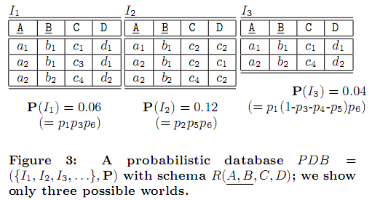
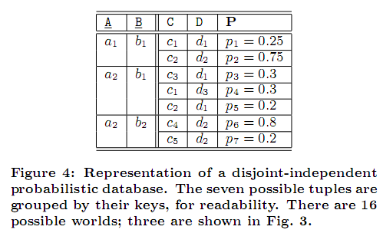
uncertainty at the tuple level
PDB is disjoint-independent if any set of possible tuples with
distinct keys is independent: ∀t1, . . . , tn ∈ T, Key(ti) ≠ Key(tj) for i ≠ j implies P(t1, . . . , tn) = P(t1) · · ·P(tn).
The c2,c1,c2 in the column D of I2 in Fig.3. are mistyped and they should be d2,d1,d2
9

Slide 10
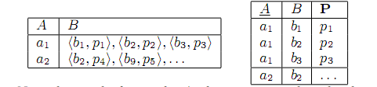
uncertainty at the ATTRIBUTE level
Many probabilistic database systems need to capture uncertainties at the attribute rather than the tuple level.
In a table S(A,B) the A-value of some tuple is known to be a1, but the B-value attribute can be b1, b2, b3, with probabilities p1, p2, p3: we must have p1 + p2 + p3 = 1
It is certain that a tuple of the form (a1,−) is in the database, only the value of B is uncertain.
There exists a simple mapping from attribute-level uncertainties to a disjoint-independent database, as illustrated above

Slide 11
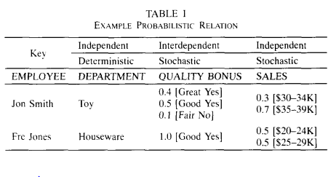
Probabilistic data model (PDM)
With missing probabilities
In this model, probabilities associated with the values of attributes.
Relations have deterministic keys, each tuple represents a known real entity
→this relation describes two entities, “Jon Smith” and “Fred Jones”
The nonkey attributes describe the propertites of the entities may be deterministic or stochastic
→The attribute DEPARTMENT is deterministic, QUALITY and BONUS are probabilistic and jointly distributed.
Prob[QUALITY = “Great” AND BONUS =
“Yes” | EMPLOYEE = “Jon Smith” ] = 0.4.
Prob[SALES = “$35-39K” | EMPLOYEE =
“Jon Smith” ] = 0.7.

Slide 12
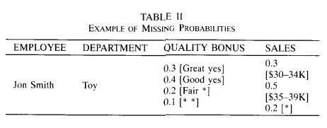
PDM with missing probabilities
The requirement could be a problem in practice because it may be difficult to know the exact probabilities for all possible domain values.
Missing probabilities to account for such incompletely specified probability distribution
e.g., There, 0.2 probability has not been assigned to a particular sales range. It is assumed that this missing probability is distributed over all ranges in the domain, but we make no assumptions as to how it is distributed.
In this model, each stochastic attribute is handled as a discrete probability distribution function
This means that the probabilities for each attribute (in a tuple) must add up to 1.0

Slide 13
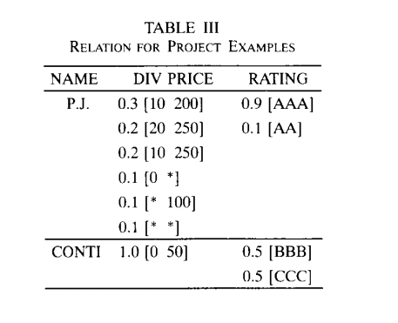
examples
The missing probabilities give us great flexibility:
e.g., for stock P.J.,
the scenario DIV = 10, PRICE = 200 occurs with at least probability 0.3. Its maximum probability is 0.4, occurring if the last scenario (DIV = *, PRICE = *) happens to cover the first.
The scenario DIV = 0, PRICE = 100 may occur with probability ranging from zero to 0.1+0.1+0.1
13

Slide 14
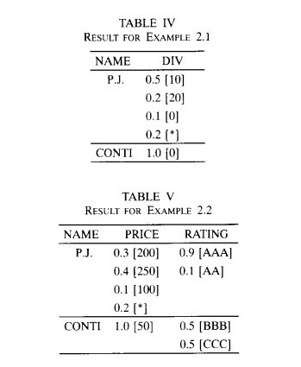
project stocks onto name, div
Project operator
In the resulting tuple for P.J., 0.2 probability is distributed over all possible DIV values because that was the amount spread over [*, 100] and [*, *] values in STOCKS.
project stocks onto name, price
The result is shown in Table V
14

Slide 15
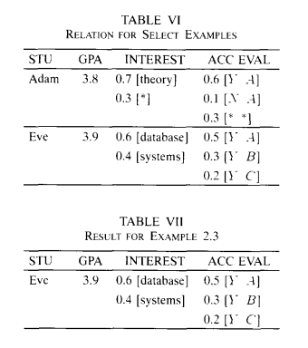
select operator
Example 2.3: SELECT APPLICANTS WHERE ACC-EVAL: V= [Y, *], P > 0.7: the result is tuple Evc (have been shown in Table VII)
Example 2.4.: SELECT APPLICANTS WHERE ACC-EVAL: v = [Y, *], p > 0.7: both tuples
Example 2.5.: SELECT APPLICANTS WHERE INTEREST: v = [ A.I. ], p > 0: tuple Adam
Example 2.6.: SELECT APPLICANTS WHERE ACC-EVAL: V = [Y, *], P = 1.0: tuple Eve
---- We use V, P to refer to the value and probability components of a certainty condition, and v, p to the components of a possibility condition
15

Slide 16
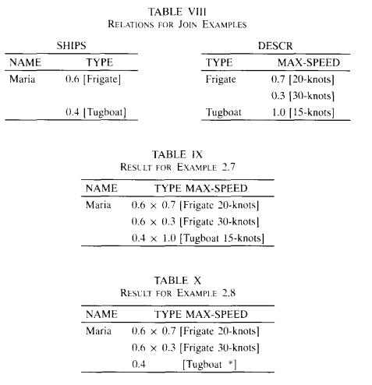
join operator
JOIN SHIPS, DESCR: There must be a common attribute, in this case, TYPE. That attribute must be the key of one of the relations. The resulting relation is shown in Table IX. (We show the resulting probabilities as products, e.g., 0.6 x 0.7, to show how they are derived.)
Natural join can generate missing probabilities, Suppose that the DESCR relation given earlier does not contain a tuple for Tugboat. The result of the join in this case would be the one shown in Table X.
16

Slide 17
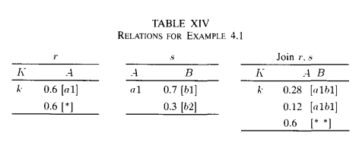
“Correctness” of the operators on missing probability
lossy operations
In the resulting join, the probability of tuple [a1 b1] ranges from 0.28 to 0.88. (This last value is obtained when all the missing probability of 0.6 is assumed to fall on [a1 b1].)
---However, we can only obtain at most 1.0x0.7 for [a1 b1] from original relations. Thus, the result we have shown does not accurately represent the join.
17

Slide 18
Conclusion
We need to learn how to manage data that is imprecise, or uncertain, and that contains an explicit representation of the uncertainty
Data integration has reached the point where it needs to cope explicitly with uncertainties
The probabilistic model offers a richer descriptive language allowing the database to more accurately reflect the uncertain real world
We believe that missing probability is a powerful concept, and it allows the model to capture uncertainty in data value as well as in the probabilities.
Missing probability provides for substantial flexibility in modelling real applications
Missing probability arises naturally during the relational operations, even when the base relations have no missing probability

Slide 19
criticism
In the research, they focused exclusively on discrete probability distribution functions, but it may be possible to extend our model to continues probabilities
It is possible to allow other interpretations for missing probabilities. Instead of assuming that missing probabilities are distributed over all domain values
“information loss” occurs when two relations are replaced by their join relation if the original relation has missing probabilities, need a solution for this issue
Another operator worth looking into is “COMBINE”
There are some aspects such as right user interface for this model, cost overhead, and the best way to organize the probabilistic data, all of them need to be discussed

